Slide 1
“Teach A Level Maths”
Statistics 1
Variance
© Christine Crisp

Slide 2
Statistics 1
AQA
EDEXCEL
OCR
"Certain images and/or photos on this presentation are the copyrighted property of JupiterImages and are being used with permission under license. These images and/or photos may not be copied or downloaded without permission from JupiterImages"

Slide 3
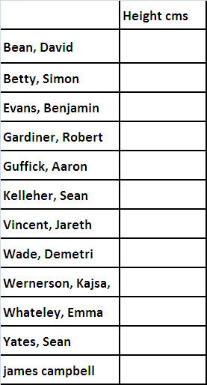
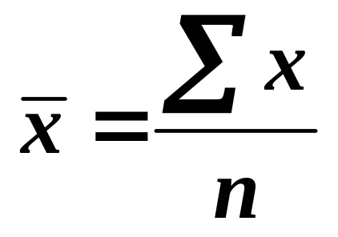
Measure your height and add it
to the spreadsheet on laptop

Slide 4

Can you find the medians and means for the following 3 data sets?
Median
Mean,
Set A
1
2
3
4
5
6
7
8
9
5
5
Set B
1
1
1
4
5
6
9
9
9
5
5
Set C
1
5
5
5
5
5
5
5
9
5
5
Although the medians and means are the same, the data sets are not really alike.
The spread or variability of the numbers is quite different.
How can we measure the spread within the data sets?
ANS: The range and inter-quartile range both measure spread but neither uses all the data items.

Slide 5


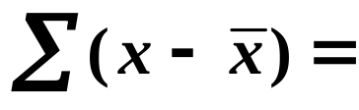
Median
Mean,
Set A
1
2
3
4
5
6
7
8
9
5
5
Set B
1
1
1
4
5
6
9
9
9
5
5
Set C
1
5
5
5
5
5
5
5
9
5
5
If you had to invent a method of measuring spread that used all the data items, what could you do?
One thing we could do is find out how far each item is from the mean and add up these differences.
e.g.
Set A: x
1
2
3
4
5
6
7
8
9
−4
−3
−2
−1
0
1
2
3
4
−4 −3 . . . + 3 + 4 =
0
Data sets B and C give the same result. The negative and positive values have cancelled each other out.

Slide 6

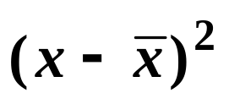
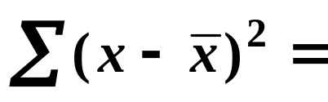

To avoid the effect of the negative values we can either
ignore the negative signs, or
square each difference ( since the squares will all be positive ).
Squaring is more convenient for developing theory, so, e.g.
Set A: x
1
2
3
4
5
6
7
8
9
−4
−3
−2
−1
0
1
2
3
4
16
9
4
1
0
1
4
9
16
Let’s do this calculation for all 3 data sets:

Slide 7




Mean,
x
Set A: x
1
2
3
4
5
6
7
8
9
5
Set B: x
1
1
1
4
5
6
9
9
9
5
Set C: x
1
5
5
5
5
5
5
5
9
5
Set A:
Set B:
Set C:
The larger value for set B shows greater variability.
Set C has least variability.
Can you see a snag with this measurement?
ANS: The calculated value increases if we have more data, so comparing data sets with different numbers of items would not be possible.
To allow for this, we divide by n, the number of items.

Slide 8
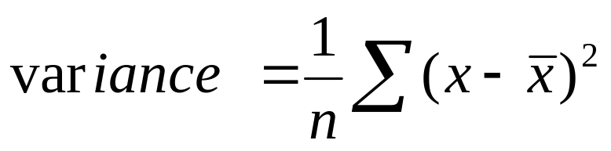
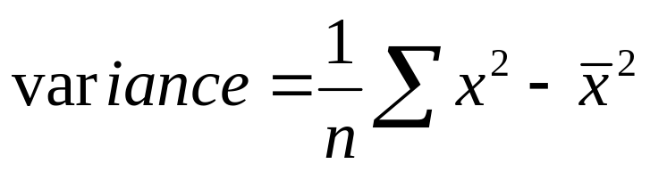
So, to measure the spread or variability in data we can use the formula
square root of variance is called the standard deviation.
However, the formula can be rewritten to make it easier to use:
It isn’t obvious that the 2 forms are the same so we will use both in the next example to check they give the same answer.
( N.B. Checking the result in this way is not a proof of the result. )

Slide 9
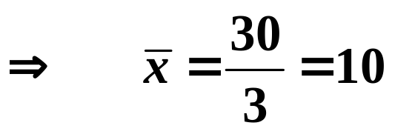
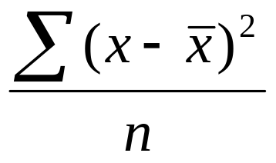
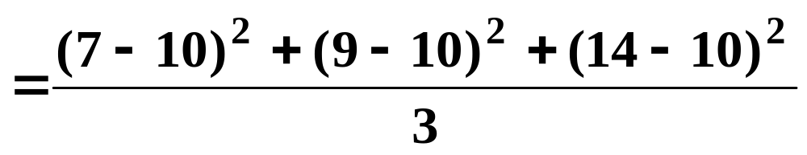
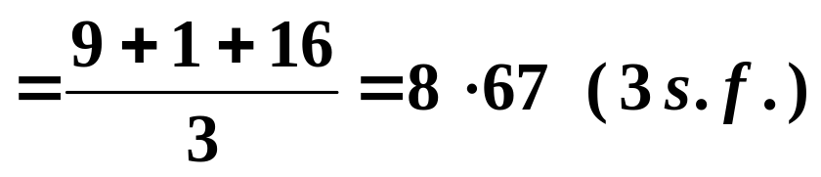
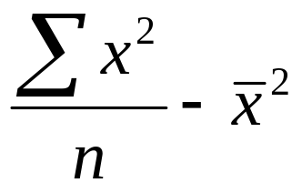
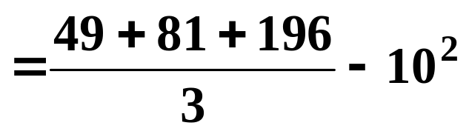
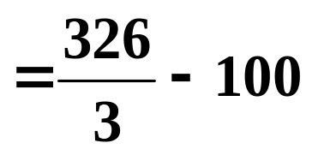

e.g. Find the mean and variance of the following data:
x | 7 | 9 | 14
Mean,
(i)
(ii)
In the 2nd form we subtract only once and this, in general, makes it quicker to use.

Slide 10
Standard deviation =

Slide 11
Heights variance using both formulae

Slide 12
Example – use these versions of
the formula to
Calculate the variance and standard deviation of the data {0, 2, 3, 6, 9}

Slide 13
Starter – preferably using the extra space in the table find the mean of this data set
Score | Frequency
2 | 10
3 | 10

Slide 14

Use this formula
to

Slide 15
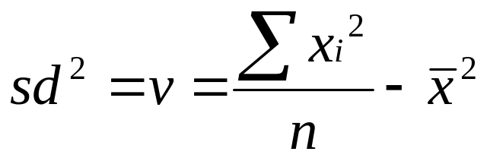
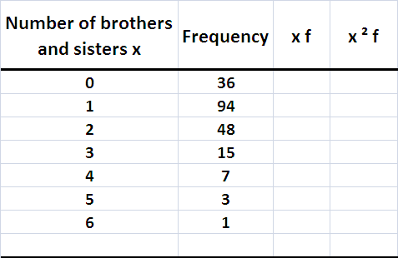
f
i
i
i
i

Slide 16
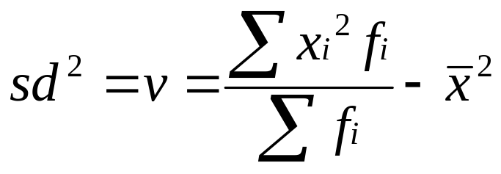

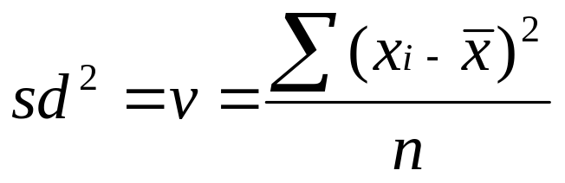
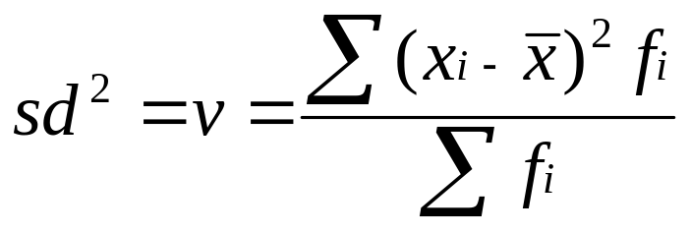
Frequency Data
The formula for the variance can be easily adapted to find the variance of frequency data.
becomes
becomes

Slide 17
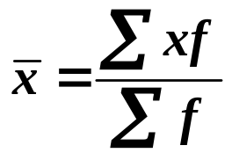
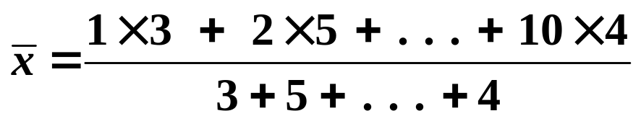


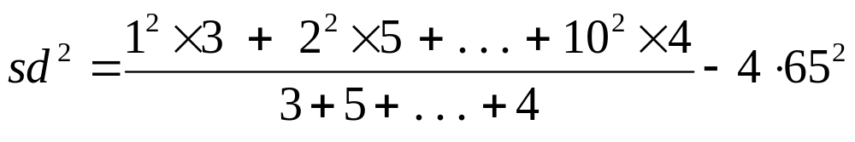

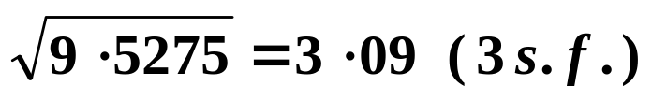
e.g.1 Find the variance and standard deviation of the following data:
x | 1 | 2 | 5 | 10
Frequency, f | 3 | 5 | 8 | 4
Solution:
mean,
variance,
standard deviation, s =

Slide 18
e.g.2 Find the standard deviation of the following lengths:
Length (cm) | 1-9 | 10-14 | 15-19 | 20-29
Frequency, f | 2 | 7 | 12 | 9
Solution:
We need the class mid-values

Slide 19
SUMMARY
To find the variance or standard deviation using the calculator functions,
the values of x ( and f ) are entered and checked
the table of values gives the standard deviation using the following notation instead of s:
standard deviation is _____
the variance is the square of the standard deviation.
write here the symbol your calculator uses

Slide 20

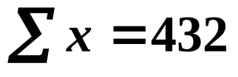
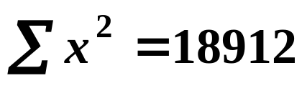
Exercise
Find the mean, standard deviation and variance for each of the following data sets, using calculator functions where appropriate.
1.
x
1
2
3
4
5
f
7
9
14
12
8
2.
Time ( mins )
1-5
6-10
11-15
16-20
21-25
f
7
9
14
12
8
3. 10 observations where and

Slide 21
Find the mean, standard deviation and variance
1.
x
1
2
3
4
5
f
7
9
14
12
8

Slide 22



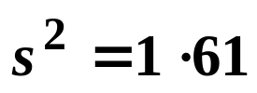


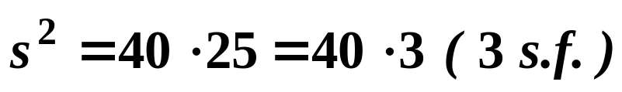
1.
x
1
2
3
4
5
f
7
9
14
12
8
Answer:
mean,
standard deviation, s =
variance,
N.B. To find we need to use the full calculator value for s not the answer to 3 s.f.
2.
Time ( mins )
1-5
6-10
11-15
16-20
21-25
x
3
8
13
18
23
f
7
9
14
12
8
Answer:
mean,
standard deviation, s =
variance,

Slide 23
Find the mean, standard deviation and variance
2.
Time ( mins )
1-5
6-10
11-15
16-20
21-25
f
7
9
14
12
8

Slide 24
1.
x
1
2
3
4
5
f
7
9
14
12
8
Answer:
mean,
standard deviation, s =
variance,
N.B. To find we need to use the full calculator value for s not the answer to 3 s.f.
2.
Time ( mins )
1-5
6-10
11-15
16-20
21-25
x
3
8
13
18
23
f
7
9
14
12
8
Answer:
mean,
standard deviation, s =
variance,

Slide 25
3. 10 observations where and

Slide 26
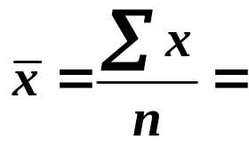

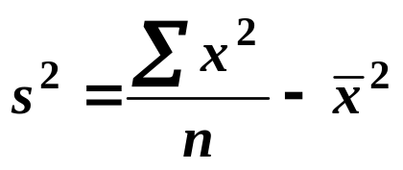



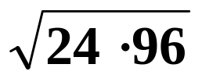

3. 10 observations where and
Solution:
mean,
variance,
Standard deviation, s =

Slide 27


e.g.1 Find the variance and standard deviation of the following data:
x | 1 | 2 | 5 | 10
Frequency, f | 3 | 5 | 8 | 4
mean,
variance,
standard deviation, s =
To find the variance using calculator functions, we enter the data in the same way as when we found the mean.
Your calculator may not show the variance in the results table but the standard deviation will be there. Two values will be given so look for 3·09 ( 3 s.f. ) and notice the notation used.
Square the standard deviation to find the variance.

Slide 28

e.g.2 Find the standard deviation of the following lengths:
Length (cm) | 1-9 | 10-14 | 15-19 | 20-29
x
Frequency, f | 2 | 7 | 12 | 9
5
12
17
24·5
Standard deviation, s =

Slide 29
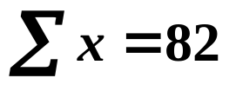
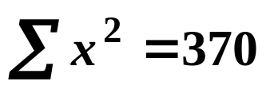

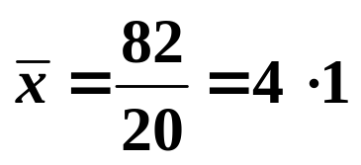
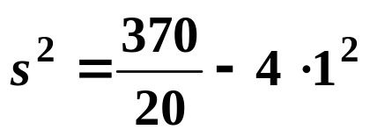

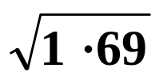

e.g.3 Find the mean and standard deviation of 20 values of x given the following:
and
Solution:
Since we only have summary data, we must use the formulae
mean,
variance,
Standard deviation, s =

Slide 30
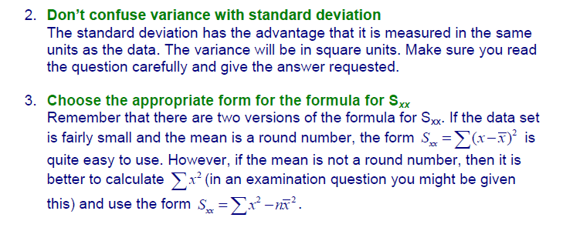
3 Useful Tips
1. If we have raw data, we can find the mean, standard deviation and variance by using the calculator functions BUT the formulae must be memorised to use with summarised data.

Slide 31
1.
x
1
2
3
4
5
f
7
9
14
12
8
Answer:
mean,
standard deviation, s =
variance,
N.B. To find we need to use the full calculator value for s not the answer to 3 s.f.
2.
Time ( mins )
1-5
6-10
11-15
16-20
21-25
x
3
8
13
18
23
f
7
9
14
12
8
Answer:
mean,
standard deviation, s =
variance,

Slide 32
3. 10 observations where and
Solution:
mean,
variance,
Standard deviation, s =

Slide 33
Outliers
We’ve already seen that an outlier is a data item that lies well away from the other data. It may be a genuine observation or an error in the data.
e.g. 1 Consider the following data:
10 | 12 | 14 | 17 | 19 | 21 | 81
With this data set, we would immediately suspect an error. The value 81 was likely to have been 18. If so, there would be a large effect on the mean and standard deviation although the median would not be affected and there would be little effect on the IQR.
The presence of possible outliers is an argument in favour of using median and IQR as measures of data.

Slide 34




In an earlier section, we met a method of identifying outliers using a measure of 1·5 × IQR above or below the median.
A 2nd method used to identify outliers is to find points that are further than 2 standard deviations from the mean.
e.g. 2. Consider the following data:
10 | 12 | 14 | 17 | 18 | 19 | 21 | 22 | 24 | 33
The mean and standard deviation are :
mean,
standard deviation, s =
So,
and
The point 33 is more than 2 standard deviations above the mean so, using this measure, it is an outlier.

Slide 35


Slide 36
The following slides contain repeats of information on earlier slides, shown without colour, so that they can be printed and photocopied.
For most purposes the slides can be printed as “Handouts” with up to 6 slides per sheet.

Slide 37
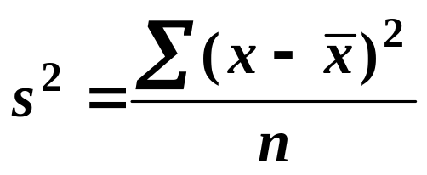

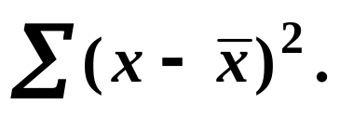
SUMMARY
The variance measures spread or variability and is given by
or
We use the 2nd form unless we are given the value of
The standard deviation is given by s, the square root of the variance.
If we have raw data, we can find the mean, standard deviation and variance by using the calculator functions BUT the formulae must be memorised to use with summarised data.

Slide 38
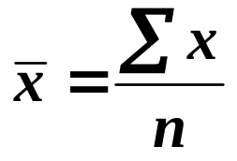
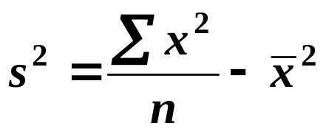
e.g. Find the mean and standard deviation of 20 values of x given the following:
and
Solution:
Since we only have summary data, we must use the formulae
mean,
variance,
Standard deviation, s =

Slide 39
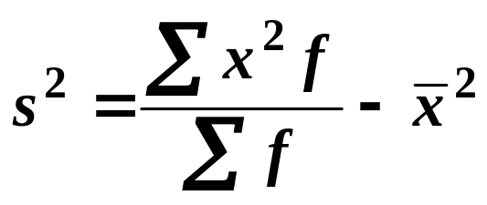
Frequency Data
The formula for the variance can be easily adapted to find the variance of frequency data.
becomes

Slide 40
SUMMARY
To find the variance or standard deviation using the calculator functions,
the values of x ( and f ) are entered and checked
the table of values gives the standard deviation using the following notation instead of s:
standard deviation is _____
the variance is the square of the standard deviation.

Slide 41
e.g. Find the standard deviation of the following lengths:
Length (cm)
1-9
10-14
15-19
20-29
Frequency, f
2
7
12
9
Solution:
We need the class mid-values
Length (cm)
1-9
10-14
15-19
20-29
x
5
12
17
24·5
Frequency, f
2
7
12
9
We can now enter the values of x and f on our calculators.
Standard deviation, s =

Slide 42
Outliers
We’ve already seen that an outlier is a data item that lies well away from the other data. It may be a genuine observation or an error in the data.
e.g. 1 Consider the following data:
10
12
14
17
19
21
81
With this data set, we would immediately suspect an error. The value 81 was likely to have been 18. If so, there would be a large effect on the mean and standard deviation although the median would not be affected and there would be little effect on the IQR.
The presence of possible outliers is an argument in favour of using median and IQR as measures of data.

Slide 43
In an earlier section, we met a method of identifying outliers using a measure of 1·5 × IQR above or below the median.
A 2nd method used to identify outliers is to find points that are further than 2 standard deviations from the mean.
e.g. 2. Consider the following data:
10
12
14
17
18
19
21
22
24
33
The mean and standard deviation are :
mean,
standard deviation, s =
So,
and
The point 33 is more than 2 standard deviations above the mean so, using this measure, it is an outlier.

